Slide 1


JFSD PROJECT
TEAM MEMBERS:​
DILEEP REDDY(2010030416)​
K. SREEVARUN(200030451)​
E. PAVAN SAI(2010030538)​
E. SHIVA GOUD(2010030542)​

Slide 2

Online University Voting System

Slide 3

OUTLINE
Abstract
Introduction
Literature Review
GitHub setup
Tools Setup & Work allocation

Slide 4

ABSTRACT
College Online Voting System is a web-based system, it automates the running of elections and surveys online. Users are individually interacting with the system. All user interaction is performed remotely through the user's browser. Before voting user should fill registration form and provide their details, that details are compared with details in college database, if data’s are match then user request form is accepted and provided by username and password, otherwise entry is going to be cancelled by administrator.
Users using their username and password log in into this system and vote on that date of election only. In this system contains two level of user’s, one is administrator level and another one is voter level.

Slide 5

PROBLEM STATEMENT
College Online Voting System provides the online registration form for the users before voting and makes the users to cast their vote online. The system is to be developed with security and user-friendly.

Slide 6
LITERATURE REVIEW
S.No | Title | Author | Journal | Year | Scope
1 | College Online Voting System | R.Divakar Subbram, V.Kowsika, K.Girinath, K.Karthick | International Journal of Aquatic Science | 2021 | Development of web-based collage voting system.
2 | Conceptual Design of E-Voting System for Academic Institution | Samuel Chris Quist, Leonard kwashie amegatse, Dilys Dickson | IJIER | 2016 | Developed a voting system for all students to be able to cast their vote without having to necessarily report to campus.

Slide 7
LITERATURE REVIEW
S.No | Title | Author | Journal | Year | Scope
3 | Online Voting system | Aakash Suryavanshi | SSRN | 2020 | Proposed online portal that is secured and have unique security feature such as unique id generation that adds another layer of security.
4 | Student Online Voting System | Raja Lakshmi, Meenakshi Nivya and K S Selvanayaki | International Journal of Trend in Research and Development | 2015 | Develops a web-based voting application using PHP.

Slide 8

GitHub Setup

Slide 9
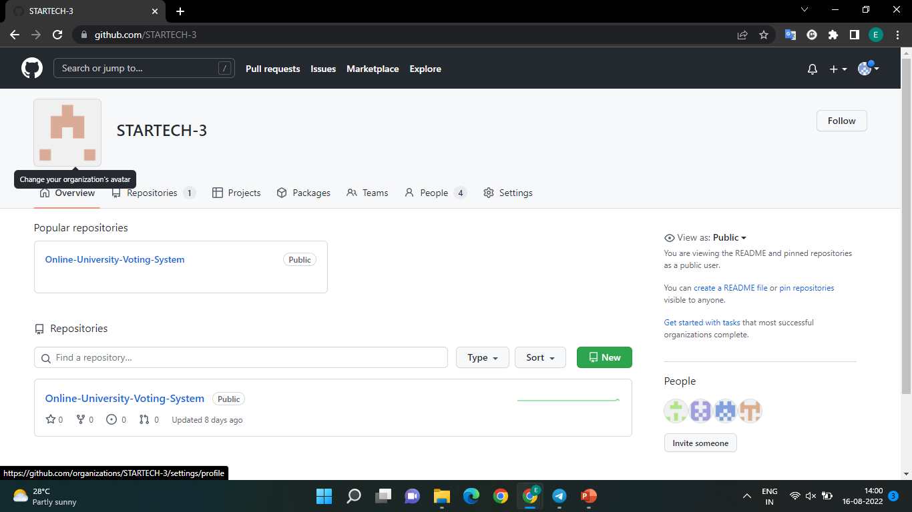

Slide 10
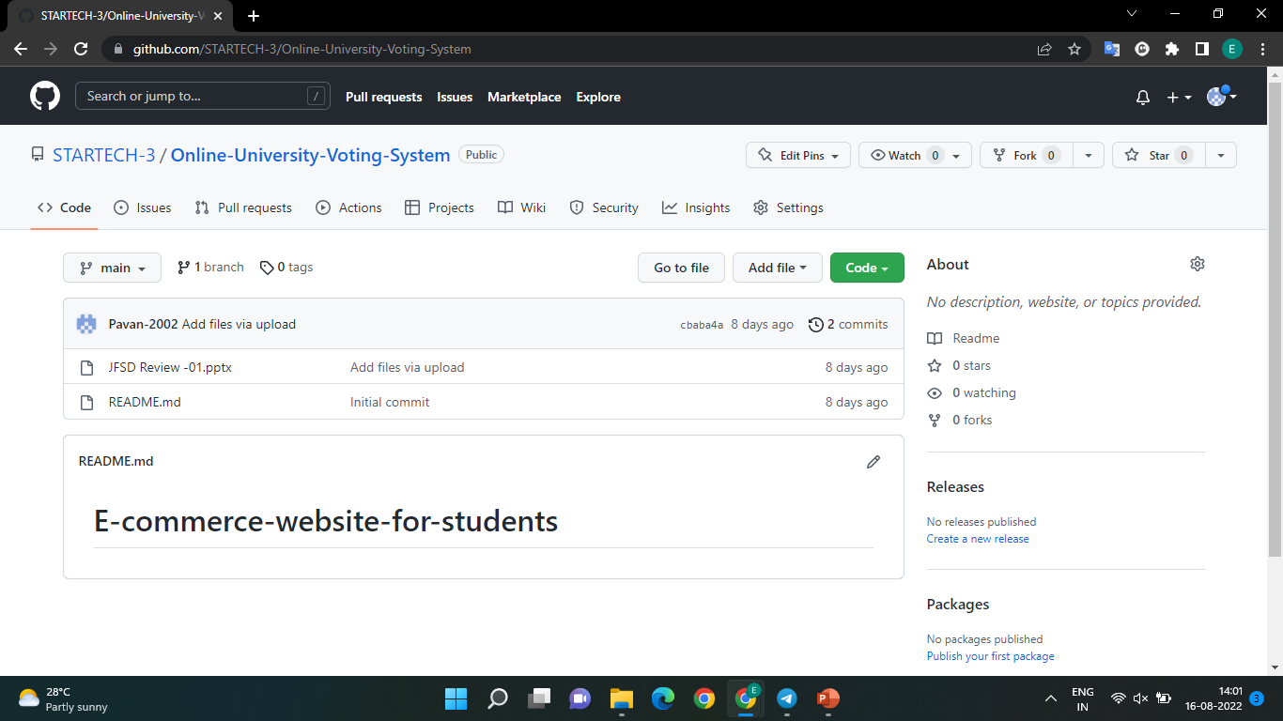

Slide 11


Slide 12




Tools Setup:
Software:
Eclipse IDE
MySQL Workbench
Tomcat server
JRE(Java Runtime Environment)
Hardware:
Processor – intel i3 or more.
RAM – 256MB or more.
ROM – 512MB or more.

Slide 13


Techniques used:
Languages/Platform:
Frontend-Html , CSS and JavaScript
Backend- MYSQL
Connectivity:
JDBC Connector

Slide 14

WORK DIVISION:
E Pavan Sai → Frontend
E Shiva Goud → Backend
K Sree Varun → Database connectivity, Backend
Dileep Reddy → Information collection ,Frontend

Slide 15


